Slide 1
Uncertainty In AI
Week-09

Slide 2
Uncertainty:
The situations that lack complete information about a particular aspect that cause ambiguity and unpredictability are considered uncertain in nature.

Slide 3
Examples:
Will it rain tomorrow?
Who will win the PSL 2030?
What will be your CGPA when you graduate?
Will the next card drawn from the deck of 52 cards be red or spade ?
What will be the number when you roll the die on your next turn?
Will it be heads on the next coin toss?
Is the cavity caused by only toothache?

Slide 4
How does AI handles Uncertainty?
In order to handle uncertainty we need to have a certain degree of belief that affirms the possibility of a certain event in a quantifiable manner.
To handle uncertainty in an event, AI and Maths both work together to provide reasoning for uncertainty

Slide 5
How Does AI handles Uncertainty
Probabilistic Reasoning
Bayesian Belief Networks
Monte Carlo Method
Decision Theory
Fuzzy Logic
Qualitative Reasoning

Slide 6
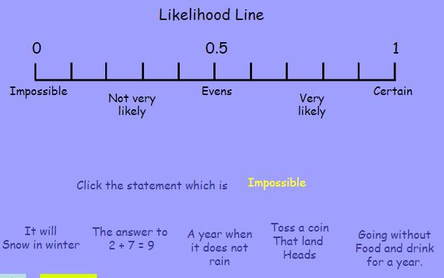
Probability:
It is a measure of how likely the event is to happen. It lies between 0-1

Slide 7
Probability: Language of Proposition
◮ Random Variable: variables like die₁, cavity , etc.
◮ Domain: The set of possible values for a variable. e.g.
die₁ = {1, 2, 3, 4, 5, 6}
What’s the domain of Weather , Cavity , Age.

Slide 8
Probability: Language of Proposition
A random variable can take on one of a set of different values, each with an associated probability. Its value at a particular time is subject to random variation.
Discrete random variables take on one of a discrete (often finite) range of values
Domain values must be exhaustive and mutually exclusive
For us, random variables will have a discrete, countable (usually finite) domain of arbitrary values.
Mathematical statistics usually calls these random elements
Example: Weather is a discrete random variable with domain
{sunny, rain, cloudy, snow}.
Example: A Boolean random variable has the domain {true,false},

Slide 9
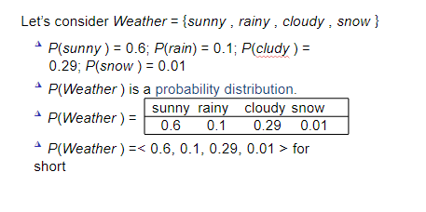
Probability: Language
Let’s consider Weather = {sunny , rainy , cloudy , snow }
◮ P(sunny ) = 0.6; P(rain) = 0.1; P(cludy ) =
0.29; P(snow ) = 0.01
◮ P(Weather ) is a probability distribution.
◮ P(Weather ) =
sunny rainy cloudy snow
0.6 0.1 0.29 0.01

Slide 10
Probability: Concepts:
◮ Sample Space: All possible worlds
◮ dice roll: Ω = (1, 6)
◮ Ω = all possible worlds; ω = one world
◮ 0 ≤ P(ω) ≤ 1 for every ω
^{◮ P}_{ω∈Ω} P(ω) = 1
Probability =No: of Favorable events/Total no; of events
What’s the possibility of obtaining a head in a coin toss? 1/2
Possibility of odd numbers in Die? = 3/6
e.g., P(1)=P(2)=P(3)=P(4)=P(5)=P(6)=1/6.

Slide 11
Probability: Axioms
Kolmogorov's axioms
◮ 0 ≤ P(ω) ≤ 1 for every ω and P _{ω∈Ω} P(ω) = 1
◮ P(¬a) =P _{ω∈¬a -} P(ω)
◮ P(¬a) = 1 − P(a)
◮ P(a ∨ b) = P(a) + P(b) − P(a ∧ b)

Slide 12
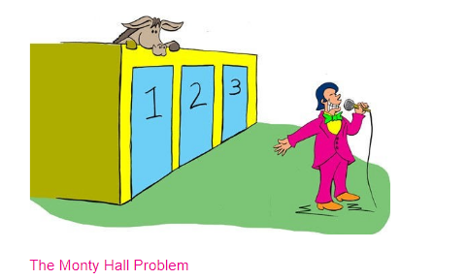
Monty Hall Problem

